Slide 1
LOAN MANAGEMENT SYSTEM PROJECT BY USING SQL
SUBTITLE : A Comprehensive Approach to Loan and Customer Analysis
PRESENTED BY :
R.P.RAJESH KANNAN

Slide 2
ABSTRACT
This project titled Loan Management System aims to streamline loan and customer data management using SQL. It integrates multiple datasets such as customer income status, loan status, customer information, country-state mapping, and regional data. Core functionalities include classifying customers based on income, calculating monthly and annual interest rates, and automating updates using triggers. Additionally, the project identifies mismatches and filters high-priority data, ensuring accuracy and efficiency. By employing advanced SQL techniques like joins, triggers, and stored procedures, the system delivers a comprehensive solution for financial data management, providing actionable insights for improved decision-making.

Slide 3
Dataset Overview
Datasets Used:
1.Customer Income Status
2.Loan Status
3.Customer Info
4.Country State
5.Region Info

Slide 4
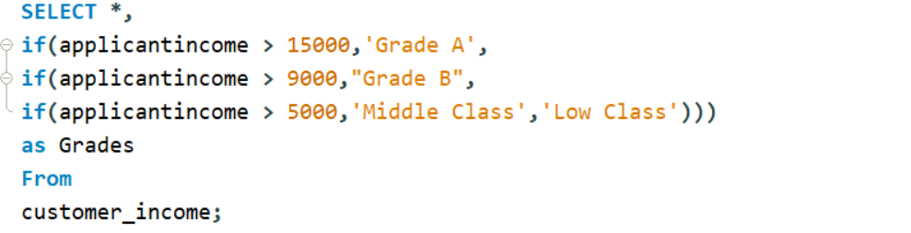
Customer Income Status
Task: Import table from Sheet 1
Steps:
Imported the table "customer income status."
Set criteria based on applicant income:
Applicant income > 15,000: Grade A
Applicant income > 9,000: Grade B
Applicant income > 5,000: Middle Class Customer
Otherwise: Low Class

Slide 5
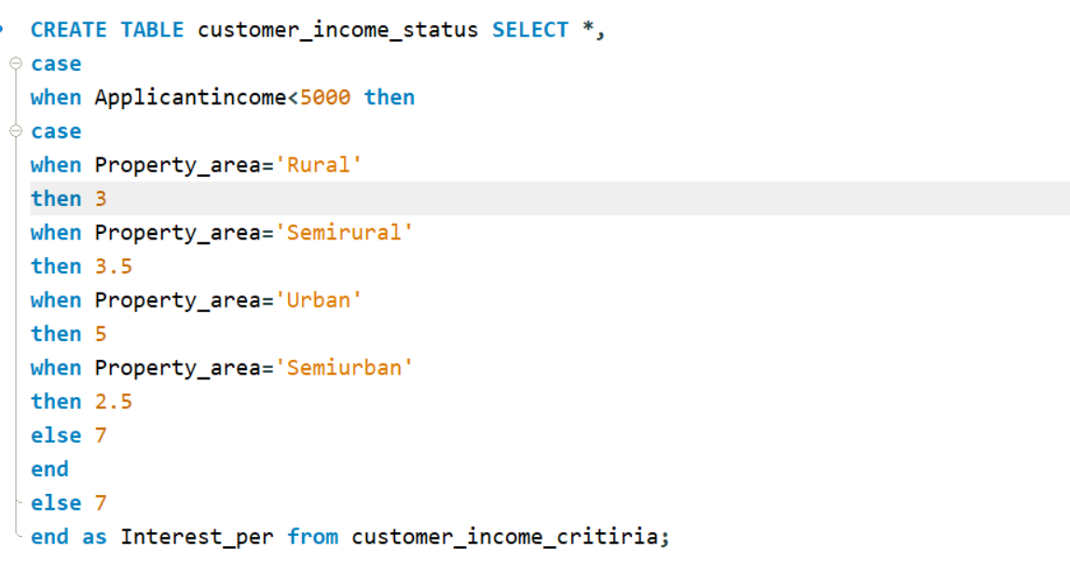
Monthly Interest Percentage
Criteria:
Applicant income < 5000 and location-based:
Rural: 3%
Semi-Rural: 3.5%
Urban: 5%
Semi-Urban: 2.5%
Otherwise: 7%

Slide 6
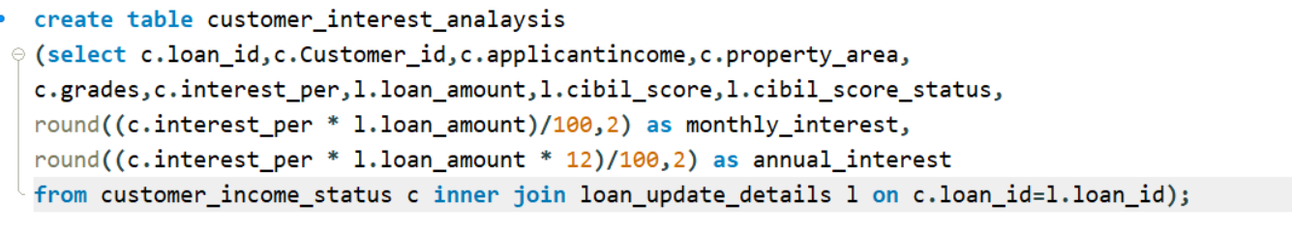
Customer Interest Analysis
New Fields:
1. Monthly Interest Amount
2. Annual Interest Amount

Slide 7
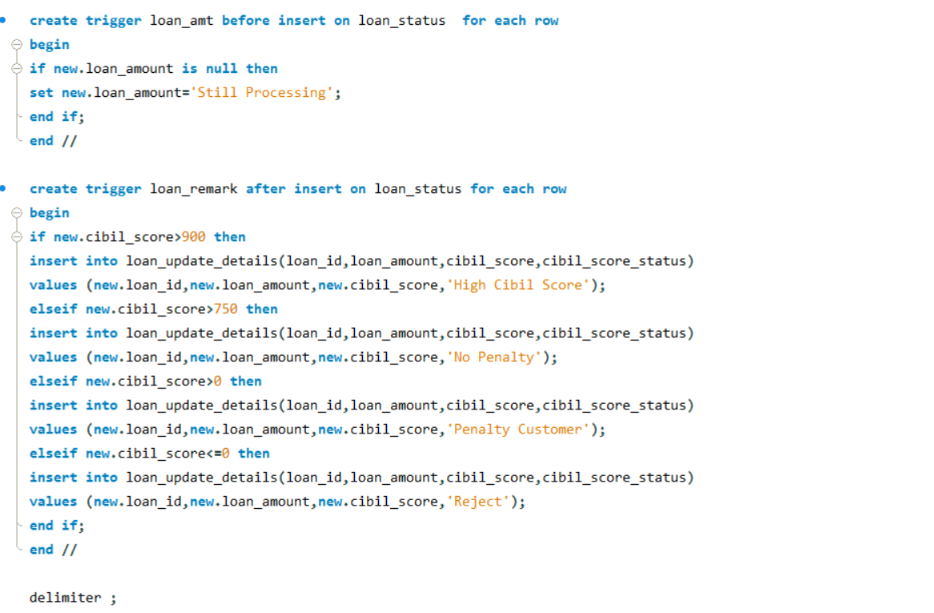
Loan Status
Row-Level Trigger for Loan Amount:
Loan amount NULL: Loan Still Processing
Statement-Level Trigger for CIBIL Score:
CIBIL Score > 900: High CIBIL Score
CIBIL Score > 750: No Penalty
CIBIL Score > 0: Penalty Customers
CIBIL Score <= 0: Rejected Customers

Slide 8
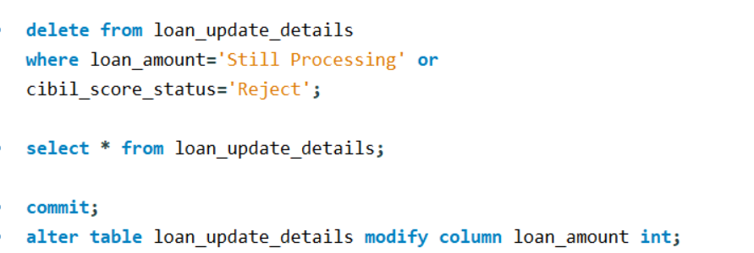
Data Cleaning and Updates
Steps:
Deleted "Rejected Customers" and "Loan Still Processing" customers.
Updated loan amounts to integers.

Slide 9
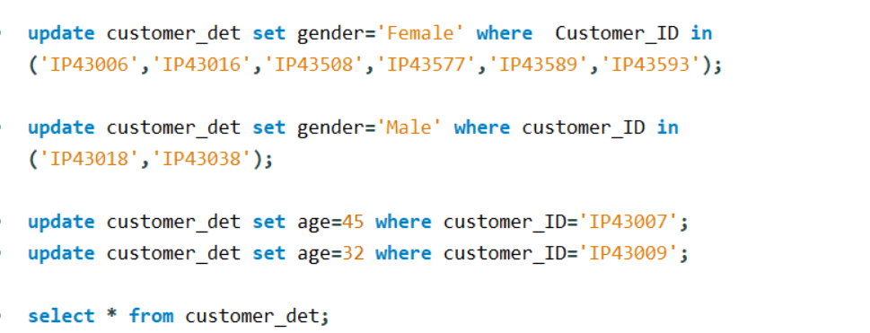
Customer Info
Steps:
Imported the table.
Updated gender and age based on customer ID.

Slide 10
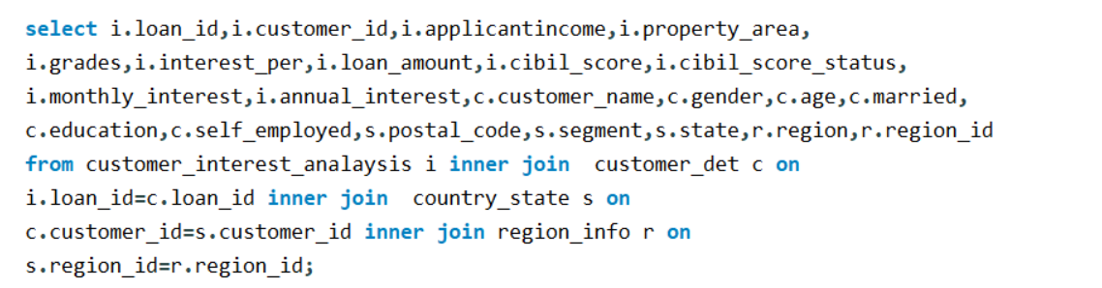
Country State and Region
Steps:
Imported tables "Country State" and "Region Info."
Joined all 5 tables without repeating fields.

Slide 11
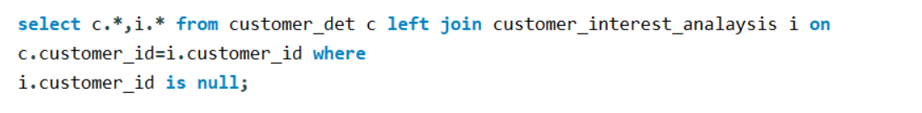
Mismatch Details
Steps:
Found mismatched details using joins.

Slide 12
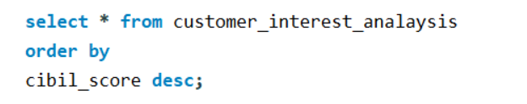
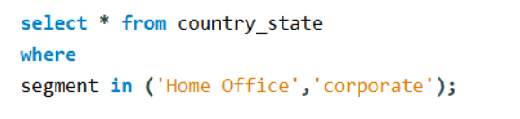
Filtered Information
Filters Applied:
1. High CIBIL Score (Query for Output 3) :
2. Home, Office, and Corporate (Query for Output 4) :

Slide 13
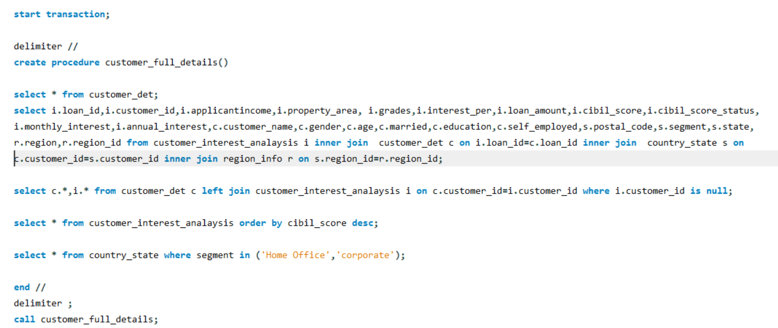
Stored Procedures
Steps:
Stored all outputs as procedures.

Slide 14
CONCLUSION
The Loan Management System effectively addresses complexities in managing large-scale loan data by automating interest calculations, enabling dynamic updates, and eliminating inconsistencies. The integration of datasets ensures seamless functionality, while the use of SQL procedures and triggers enhances the system's adaptability. Key features like CIBIL score analysis and customer categorization add value to the decision-making process. Overall, the project showcases the efficiency of SQL in handling intricate financial data, emphasizing its role in delivering robust, scalable, and accurate management systems.

Slide 15
THANK YOU…!

